Slide 1
Agentic Development of Agentic Vehicle Ordering
A GCSP Story

Slide 2
The goal of the demo
1. Demonstrate the power of agentic development
Show the Used Cars sites.
Easy – job done.

Slide 3
Two goals with one demo
1. Demonstrate the power of agentic development
2. Demonstrate how we can build exciting new user experiences on top of GCSP

Slide 4
The problems
Choices and Preferences are hugely popular, driving employee satisfaction and retention. Users aim to identify the best vehicle which a) is available, b) they are entitled to, c) is affordable in their Points or GBP budget (depending on scheme)
However, the release process Vehicles are released infrequently and cause a Glastonbury tickets-style scrum
Users are losing productive office hours to manually checking and selecting their next vehicle.
Users who are unable to be online at the time of a release find that they are unlikely to find their preferred vehicle.
A related problem is the lack of a feedback loop between supply and demand, so the employee car ordering team must work with incomplete data
Whilst GCSP provides a vastly improved user experience and interface, it does not yet address these challenges

Slide 5
Proposal:
Hill Statement
Our solution must ensure employees are at least as satisfied as today with the vehicle they end up with, whilst spending less effort to achieve this.
1. An agentic GCSP Buddy, which identifies the most appropriate car in a given release according to a user’s preferences, and automatically offers it to them for acceptance.
2. A means for the employee car ordering team to visualize user preferences and vehicle selections, allowing them to more accurately order future builds.

Slide 6
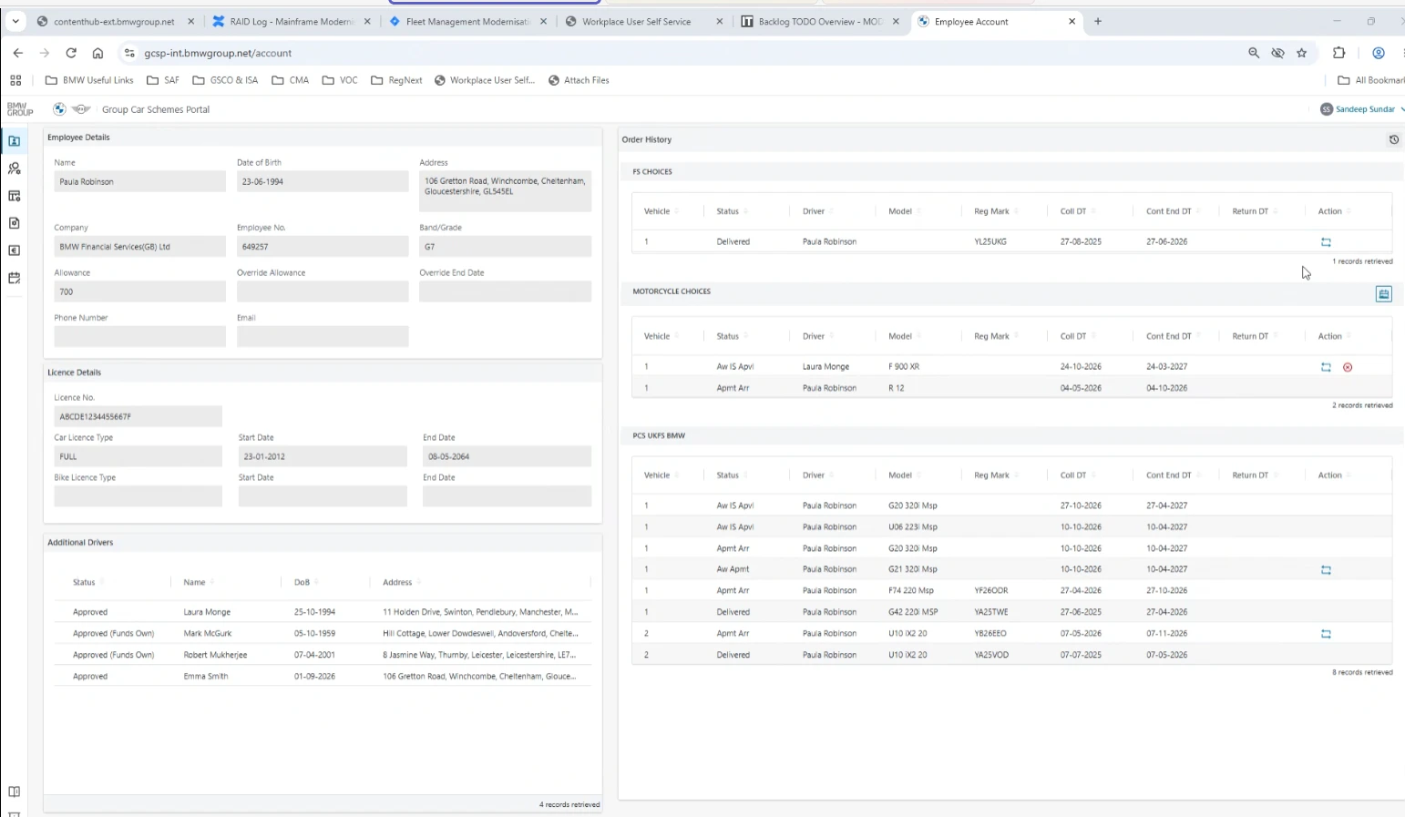
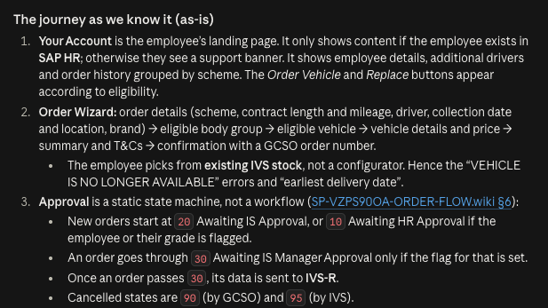
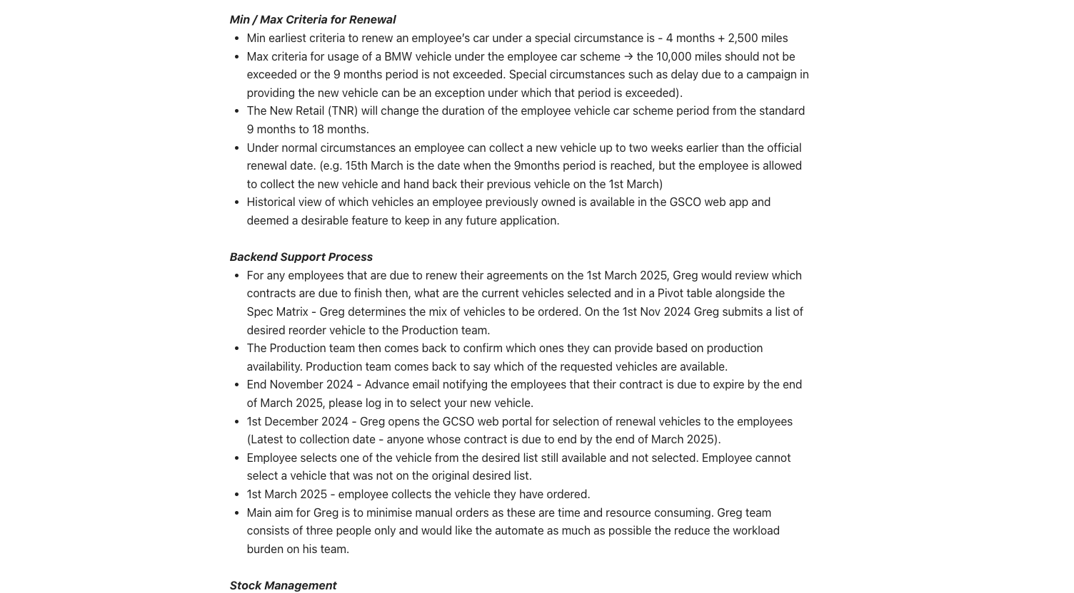
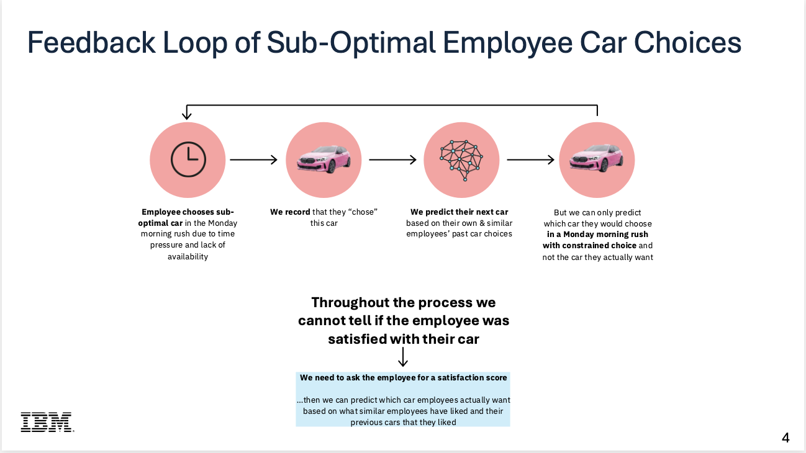
Inputs

Slide 7
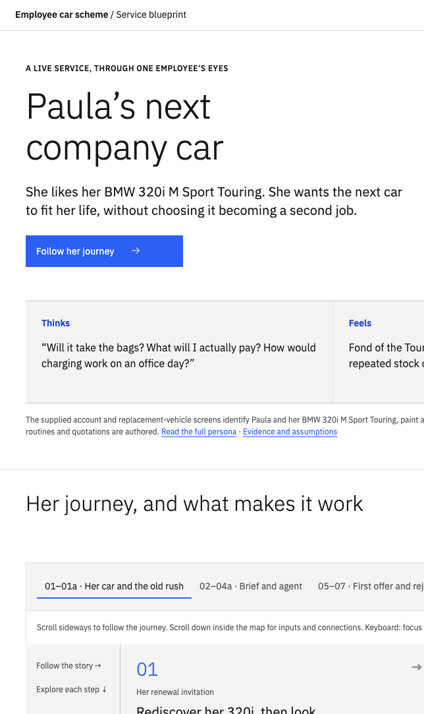
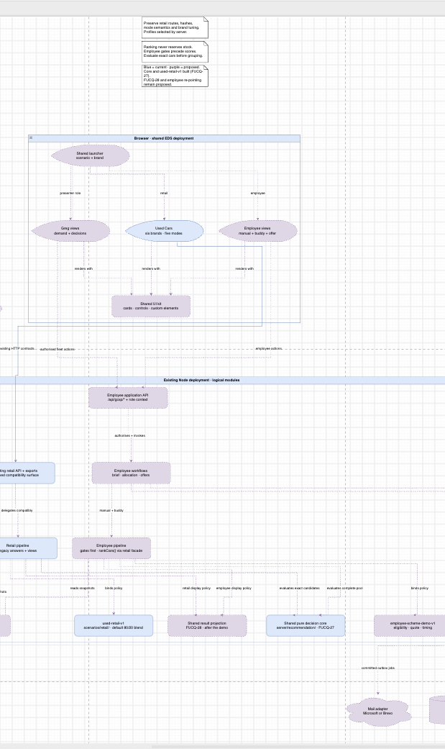
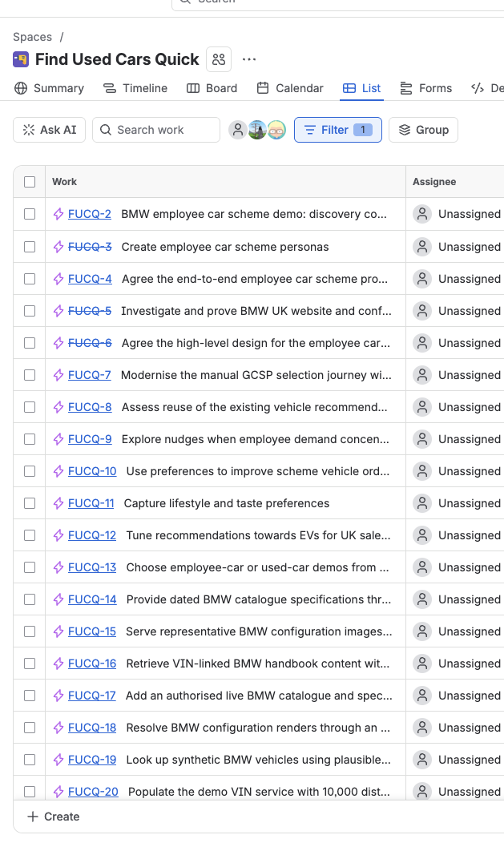

Slide 8
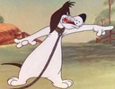









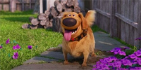





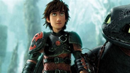



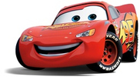


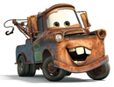





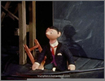




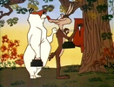
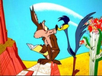
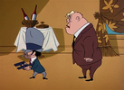
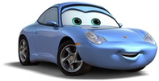








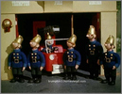
Barnyard Dawg
Baymax
Beaky Buzzard
Bertie
Bugs Bunny
Buzz Lightyear
Cecil Turtle
Charlie Dog
Cool Cat
Donald Duck
Dug
Edna Mode
Emmet
Foghorn Leghorn
Foxy
Granny
Hiccup & Toothless
Hippety Hopper
Hugo
LEGO Batman
Lightning McQueen
Marvin the Martian
Mary-Ellen Walton
Mater
Merlin the Magic Mouse
Michigan J. Frog
Mickey Mouse
Mike Wazowski
Minnie Mouse
Mr Troop
Mulan
Pinky & the Brain
Pluto
Pussyfoot
Ralph Wolf &
Sam Sheepdog
Road Runner &
Wile E. Coyote
Rocky & Mugsy
Sally Carrera
Scooby-Doo
Scrappy-Doo
Shaggy
Sniffles
Sulley
Sylvester
Taz
Timon
Captain Flack, Pugh & Grubb
Notes:
Cast of vehicle-matcher agents, deduplicated before this slide-making request. 54 unique recorded names represented in 47 images. Current slide-production helpers are outside the historical cutoff.
Name corrections: Mary-Sue Walton was corrected by the user to Mary-Ellen Walton (The Waltons, Judy Norton). Doug the Dog is shown as Dug (Up). Timone is shown as Timon (The Lion King). Grub is shown as Grubb (Trumpton).
Grouped portraits: Captain Flack, Pugh and Grubb share the Trumpton fire brigade; Pinky and the Brain; Ralph Wolf and Sam Sheepdog; Road Runner and Wile E. Coyote; Rocky and Mugsy; Hiccup and Toothless.
Artwork belongs to the respective studios and rights holders. No reuse licence independently verified. Source list follows.
Barnyard Dawg
https://en.wikipedia.org/wiki/Barnyard_Dawg
https://upload.wikimedia.org/wikipedia/en/8/8a/Barnyarddawg.jpg?utm_source=en.wikipedia.org&utm_campaign=api&utm_content=original
Baymax
https://en.wikipedia.org/wiki/File:Baymax_from_Disney%27s_Big_Hero_6.png
https://upload.wikimedia.org/wikipedia/en/2/2c/Baymax_from_Disney%27s_Big_Hero_6.png?utm_source=en.wikipedia.org&utm_campaign=imageinfo&utm_content=thumbnail_unscaled
Beaky Buzzard
https://en.wikipedia.org/wiki/Beaky_Buzzard
https://upload.wikimedia.org/wikipedia/en/4/42/Beaky.jpg?utm_source=en.wikipedia.org&utm_campaign=api&utm_content=original
Bertie
https://en.wikipedia.org/wiki/Hubie_and_Bertie
https://upload.wikimedia.org/wikipedia/en/1/1f/Hubie_and_Bertie.jpg?utm_source=en.wikipedia.org&utm_campaign=api&utm_content=original
Bugs Bunny
Source recorded in asset manifest
Buzz Lightyear
https://en.wikipedia.org/wiki/Buzz_Lightyear
https://upload.wikimedia.org/wikipedia/commons/0/02/Buzz_Lightyear_sculpture_of_Toy_Story_Hotel_Shanghai_%28cropped%29.jpg?utm_source=en.wikipedia.org&utm_campaign=api&utm_content=original
Cecil Turtle
https://en.wikipedia.org/wiki/Cecil_Turtle
https://upload.wikimedia.org/wikipedia/en/4/4a/Cecil_Turtle.png
Charlie Dog
https://looneytunes.fandom.com/wiki/Charlie_Dog
https://static.wikia.nocookie.net/looneytunes/images/0/09/Charliedog.jpg/revision/latest/scale-to-width-down/125?cb=20110211174406
Cool Cat
https://en.wikipedia.org/wiki/Cool_Cat_%28Looney_Tunes%29
https://upload.wikimedia.org/wikipedia/en/9/98/Cool_Cat_Looney_Tunes.png?utm_source=en.wikipedia.org&utm_campaign=api&utm_content=original
Donald Duck
https://en.wikipedia.org/wiki/Donald_Duck
https://upload.wikimedia.org/wikipedia/en/a/a5/Donald_Duck_angry_transparent_background.png
Dug
https://www.cbr.com/lightyear-sox-up-dug-which-pixar-talking-animal-better/
https://static1.cbrimages.com/wordpress/wp-content/uploads/2022/05/pixar-dug.jpg
Edna Mode
https://en.wikipedia.org/wiki/Edna_Mode
https://upload.wikimedia.org/wikipedia/en/f/fc/Edna_Mode_promotional_image.png
Emmet
https://ederundbach.de/emmet-brickowski-from-the-lego-movie/
https://vignette2.wikia.nocookie.net/lego/images/b/b6/Emmet-legos-lego-movie.jpg/revision/latest?cb=20140831235247
Foghorn Leghorn
https://en.wikipedia.org/wiki/Foghorn_Leghorn
https://upload.wikimedia.org/wikipedia/en/a/a0/Foghorn_Leghorn.png
Foxy
https://loathsomecharacters.miraheze.org/wiki/Foxy_(Merrie_Melodies)
https://static.wikitide.net/loathsomecharacterswiki/thumb/1/1f/MM_Foxy.png/640px-MM_Foxy.png
Granny
https://en.wikipedia.org/wiki/Granny_%28Looney_Tunes%29
https://upload.wikimedia.org/wikipedia/en/c/ca/Granny_%28Looney_Tunes%29.png?utm_source=en.wikipedia.org&utm_campaign=api&utm_content=thumbnail_unscaled
Hiccup & Toothless
https://movieweb.com/joker-2-fan-quentin-tarantino-explained/
https://static1.moviewebimages.com/wordpress/wp-content/uploads/2024/11/hiccup-and-toothless-in-how-to-train-your-dragon.jpg
Hippety Hopper
https://en.wikipedia.org/wiki/Hippety_Hopper
https://upload.wikimedia.org/wikipedia/en/3/3a/Hippety_Hopper.png?utm_source=en.wikipedia.org&utm_campaign=api&utm_content=thumbnail_unscaled
Hugo
https://en.wikipedia.org/wiki/Hugo_the_Abominable_Snowman
https://upload.wikimedia.org/wikipedia/en/4/4e/Hugo_the_Abominable_Snowman.webp?utm_source=en.wikipedia.org&utm_campaign=api&utm_content=thumbnail_unscaled
LEGO Batman
https://www.pngmart.com/image/749861
https://www.pngmart.com/files/23/Lego-Batman-PNG-HD-Isolated.png
Lightning McQueen
https://en.wikipedia.org/wiki/File:Lightning_McQueen.png
https://upload.wikimedia.org/wikipedia/en/8/82/Lightning_McQueen.png?utm_source=en.wikipedia.org&utm_campaign=imageinfo&utm_content=thumbnail_unscaled
Marvin the Martian
https://en.wikipedia.org/wiki/Marvin_the_Martian
https://thumb.wikimedia.org/wikipedia/en/thumb/d/d5/Marvin_the_Martian.svg/330px-Marvin_the_Martian.svg.png
Mary-Ellen Walton
https://www.tvmaze.com/characters/211899/the-waltons-mary-ellen-walton
https://static.tvmaze.com/uploads/images/medium_portrait/640/1601790.jpg
Mater
https://en.wikipedia.org/wiki/File:Mater_(Cars).png
https://upload.wikimedia.org/wikipedia/en/f/f7/Mater_%28Cars%29.png?utm_source=en.wikipedia.org&utm_campaign=imageinfo&utm_content=thumbnail_unscaled
Merlin the Magic Mouse
https://en.wikipedia.org/wiki/Merlin_the_Magic_Mouse
https://thumb.wikimedia.org/wikipedia/en/thumb/1/1c/Merlin_the_Magic_Mouse_and_Second_Banana.jpg/330px-Merlin_the_Magic_Mouse_and_Second_Banana.jpg?utm_source=en.wikipedia.org&utm_campaign=api&utm_content=thumbnail
Michigan J. Frog
https://en.wikipedia.org/wiki/Michigan_J._Frog
https://thumb.wikimedia.org/wikipedia/en/thumb/3/3d/Michigan_J_Frog.svg/330px-Michigan_J_Frog.svg.png?utm_source=en.wikipedia.org&utm_campaign=api&utm_content=thumbnail
Mickey Mouse
https://en.wikipedia.org/wiki/Mickey_Mouse
https://thumb.wikimedia.org/wikipedia/commons/thumb/4/4f/Mickey_Mouse_%28poster_version%29.svg/330px-Mickey_Mouse_%28poster_version%29.svg.png
Mike Wazowski
https://en.wikipedia.org/wiki/File:Mike_Wazowski.png
https://upload.wikimedia.org/wikipedia/en/6/6a/Mike_Wazowski.png?utm_source=en.wikipedia.org&utm_campaign=imageinfo&utm_content=thumbnail_unscaled
Minnie Mouse
https://en.wikipedia.org/wiki/Minnie_Mouse
https://upload.wikimedia.org/wikipedia/commons/8/8c/Minnie_Mouse.svg
Mr Troop
https://trumpton3.homestead.com/TrumptonPt2.html
https://trumpton3.homestead.com/TrumptonPeople/Mr.Troop.JPG
Mulan
https://comicvine.gamespot.com/mulan/4005-58051/
https://comicvine.gamespot.com/a/uploads/scale_super/6/60392/1716995-mulan.jpg
Pinky & the Brain
https://wallpapers.com/wallpapers/pinky-and-the-brain-white-background-bbnqcnj4hnil7kf7.html
https://wallpapers.com/images/hd/pinky-and-the-brain-white-background-bbnqcnj4hnil7kf7.jpg
Pluto
https://www.pngplay.com/image/136896
https://www.pngplay.com/wp-content/uploads/7/Disney-Pluto-Sitting-Background-PNG-Image.png
Pussyfoot
https://www.primevideo.com/detail/0T63FWMO051NJ3UJ6AR0BIGAAF
https://m.media-amazon.com/images/S/pv-target-images/79887c2f5a9bc7f2311fdc289b9e0ba9cdfa3c9c6ea66df5fce42d1c2c0eb6f0.jpg
Ralph Wolf & Sam Sheepdog
https://en.wikipedia.org/wiki/Ralph_Wolf_and_Sam_Sheepdog
https://thumb.wikimedia.org/wikipedia/en/thumb/9/90/Sam_and_Ralph_clock.png/330px-Sam_and_Ralph_clock.png?utm_source=en.wikipedia.org&utm_campaign=api&utm_content=thumbnail
Road Runner & Wile E. Coyote
Source recorded in asset manifest
Rocky & Mugsy
https://looneytunes.fandom.com/wiki/Rocky_and_Mugsy
https://static.wikia.nocookie.net/looneytunes/images/5/5d/RockyandMugsyProfile.png/revision/latest/scale-to-width-down/1200?cb=20240715203651
Sally Carrera
https://en.wikipedia.org/wiki/File:Sally_Carrera.png
https://upload.wikimedia.org/wikipedia/en/e/e1/Sally_Carrera.png?utm_source=en.wikipedia.org&utm_campaign=imageinfo&utm_content=thumbnail_unscaled
Scooby-Doo
https://en.wikipedia.org/wiki/Scooby-Doo_%28character%29
https://upload.wikimedia.org/wikipedia/en/5/53/Scooby-Doo.png?utm_source=en.wikipedia.org&utm_campaign=api&utm_content=thumbnail_unscaled
Scrappy-Doo
https://www.reviewjournal.com/entertainment/entertainment-columns/christopher-lawrence/9-of-the-worst-characters-in-movies-and-tv/
https://www.reviewjournal.com/wp-content/uploads/2017/12/9799538_web1_copy_img_scrappy_0.jpg
Shaggy
https://wallpapers.com/shaggy-rogers
https://wallpapers.com/images/hd/shaggy-rogers-lkhmkv3v4gr855w4.jpg
Sniffles
https://loathsomecharacters.miraheze.org/wiki/Sniffles_(Looney_Tunes,_1939-1941)
https://static.wikitide.net/loathsomecharacterswiki/thumb/3/3a/Sniffles_the_Mouse.png/640px-Sniffles_the_Mouse.png
Sulley
https://www.imagui.com/a/sulley-monsters-inc-TX8ayXXoj
http://toysforkids.gr/sites/toysforkids.gr/files/images/products/bullyland/bu012583.jpg
Sylvester
https://en.wikipedia.org/wiki/Sylvester_the_Cat
https://thumb.wikimedia.org/wikipedia/en/thumb/8/82/Sylvester_the_Cat.svg/330px-Sylvester_the_Cat.svg.png
Taz
https://en.wikipedia.org/wiki/Tasmanian_Devil_%28Looney_Tunes%29
https://upload.wikimedia.org/wikipedia/en/c/c4/Taz-Looney_Tunes.svg?utm_source=en.wikipedia.org&utm_campaign=api&utm_content=original
Timon
https://purepng.com/photo/26828/clipart-the-lion-king-timon
https://purepng.com/public/uploads/large/purepng.com-the-lion-king-timonlion-kinglionking1994epic-musicalwalt-disneyanimation-17015286221887esac.png
Captain Flack, Pugh & Grubb
https://trumpton3.homestead.com/TrumptonPt2.html
https://trumpton3.homestead.com/TrumptonPeople/Firemen.JPG

Slide 9
Stop banging on about the method and show us the demo.

Slide 10
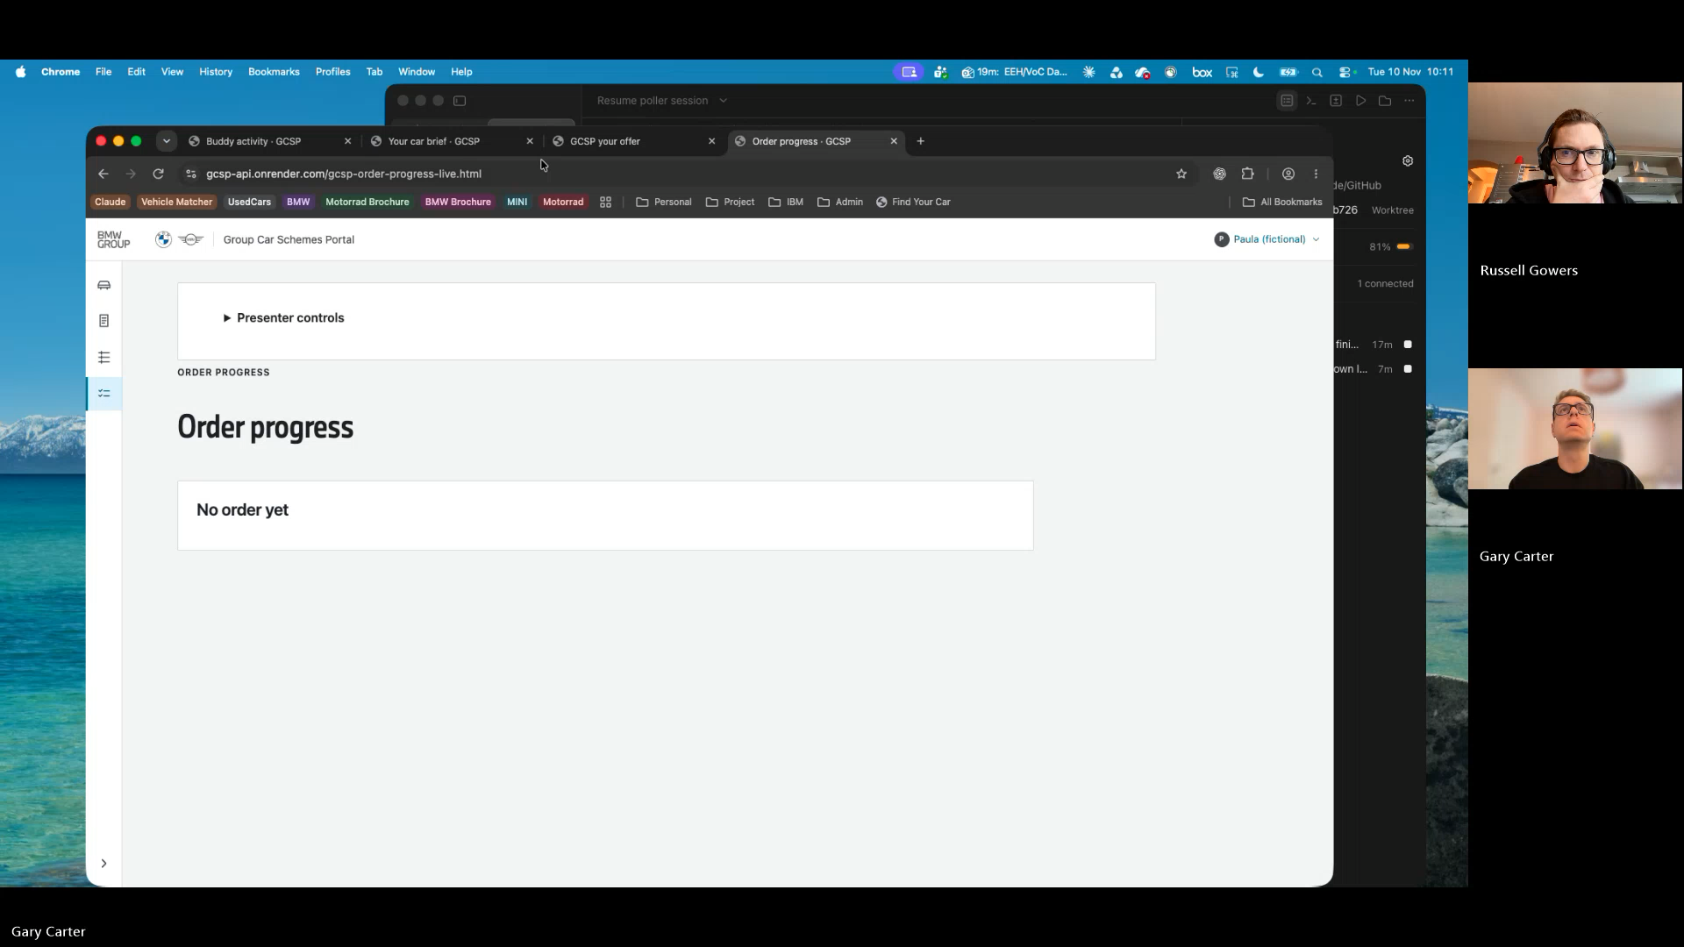
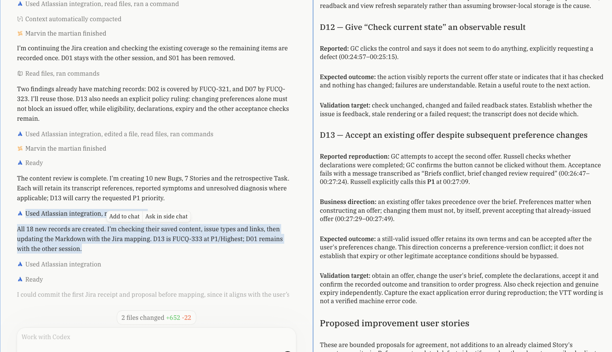
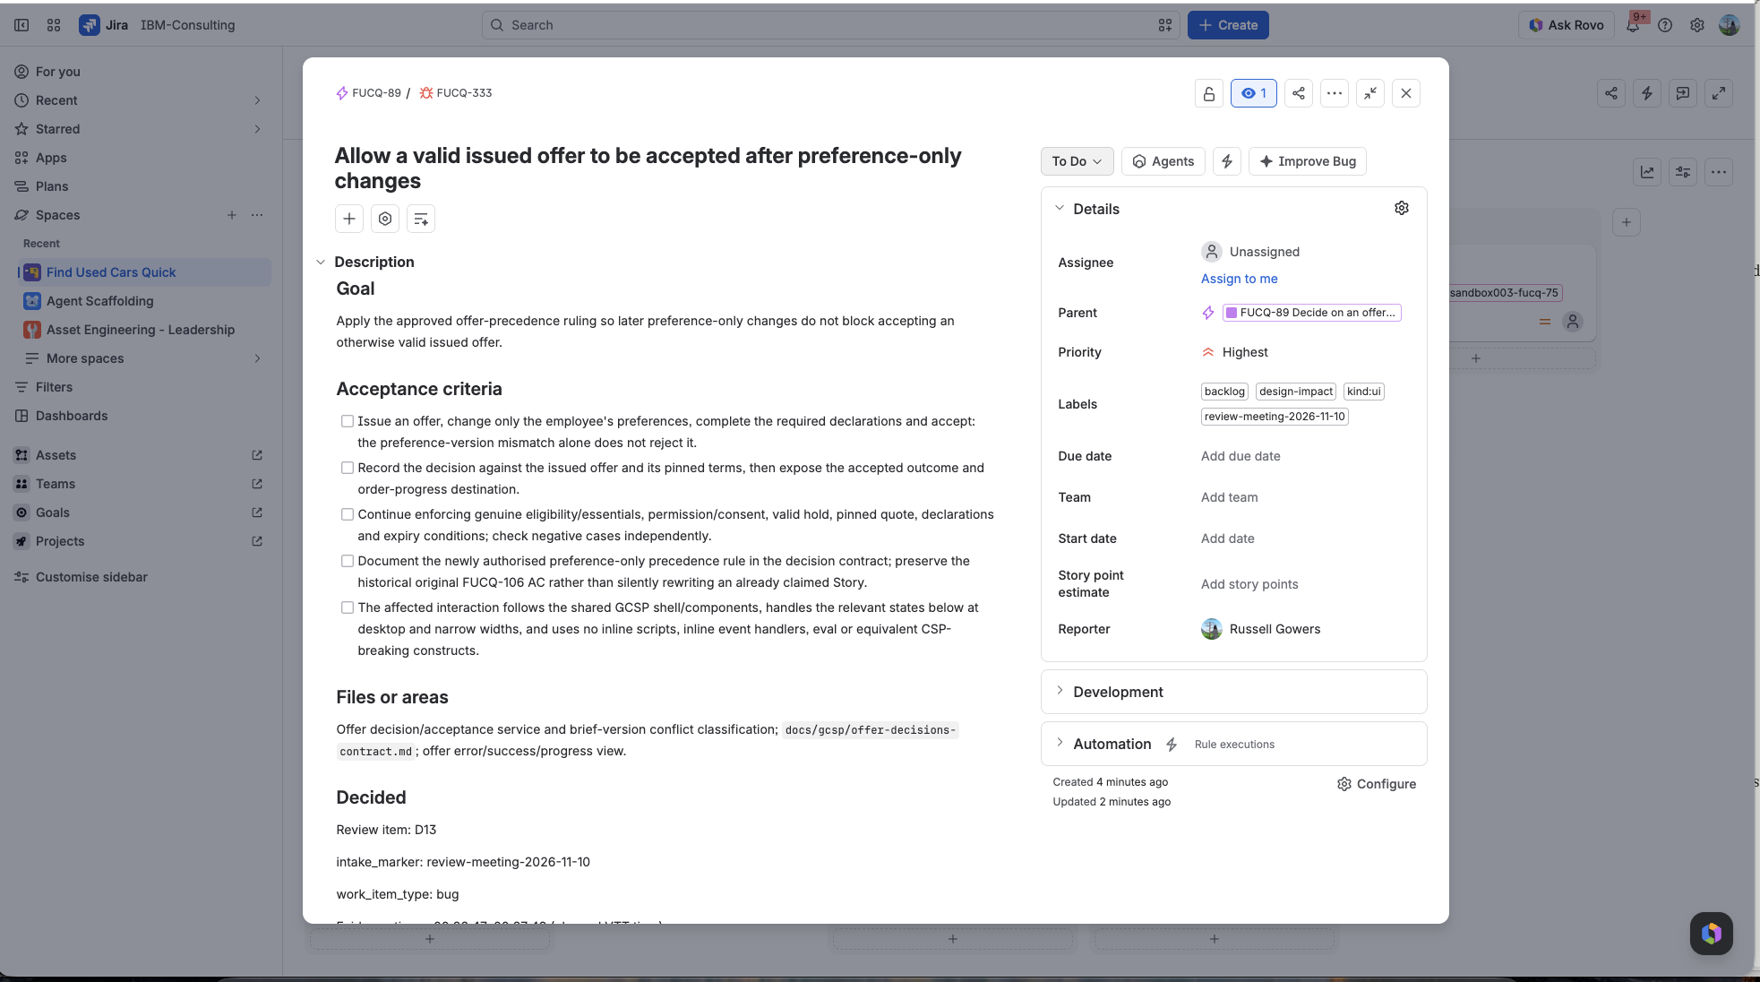
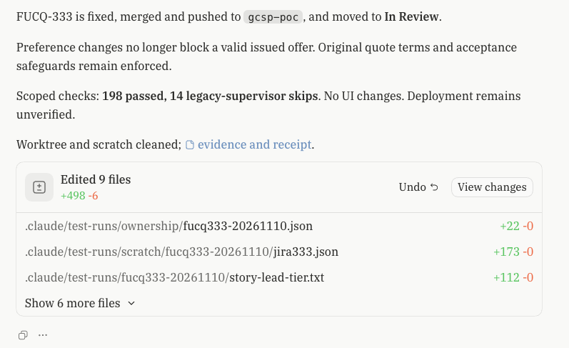
Feedback Process

Slide 11
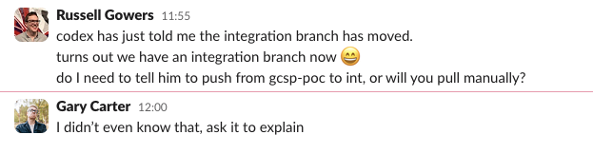
Lessons learned
AI can be as unruly as a dev team
  “Why have you done that?”
  “Stop spending all your time fixing tiny bugs”
The butterfly effect
  Decide in haste, repent at leisure
  And how do you visualize all your decisions?
Stop and think
  Take time-out each day for the humans to review progress
  Make sure we understand what’s been done, what’s planned, and whether it is still meeting the brief

Slide 12
Over to you.
- Tell us what you’d improve or change.
- What did we miss?
- Claude is listening to the transcript AND Ella is writing things down.
Notes:
Interactive section. (Keep a bit of mystique but let them know what it’s for)
This is a live test of a new capability, we don’t know if it’s going to work or not, you’ll find out later

